Slide 1


By, Sai Charan Merugu Sai Gottumukkala Swetha Guntupalli Karishma Bollineni
Essay summarization and automated grading system

Slide 2
Problem Statement
Nowadays, instructorsare often overwhelmed by the amounts of essay correction they need to grade everyday. Traditional methods of evaluation consumes ample amounts of time and heavily relies on manualefforts. Besides, it can also be inconsistent and biased at times.
Lack of an efficient system that can do this job instead ofthe actual person, thereby saving some time, triggered us with this idea.
This paved ways for our project idea that can summarize the essay andgrade it accordingly. The summarized essay will serve as a quick review option if the instructor choosesto re-verify the grade assigned.

Slide 3

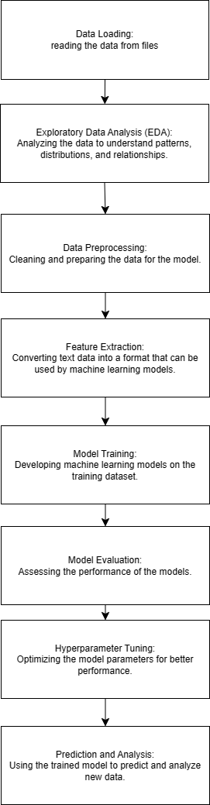
CSCE 530
Model/Methodology
Overall Workflow Diagram
Data Loading: Reading the data from files.
Exploratory Data Analysis (EDA): Analyzing the data to understand patterns, distributions, and relationships.
Data Preprocessing: Cleaning and preparing the data for the model.
Feature Extraction: Converting text data into a format that can be used by machine learning models.
Model Training: Developing machine learning models on the training dataset.
Model Evaluation: Assessing the performance of the models.
Hyperparameter Tuning: Optimizing the model parameters for better performance.
Prediction and Analysis: Using the trained model to predict and analyze new data.

Slide 4


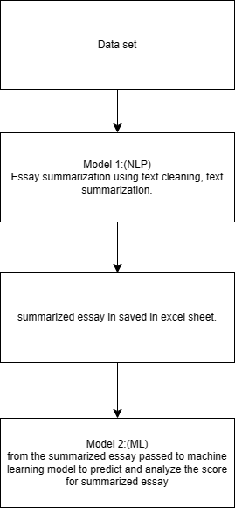
CSCE 5300
CSCE 5300
CSCE 5300
Architecture diagram of model
Model 1:NLP
After analyzing the essay ,it undergoes to text cleaning and text summarization. This summarized essay is saved as excel sheet along with score.
Model 2:Machine Learning:
The summarized essay saved from excel under go preprocessing ,then passed to model . The model will learning from the data and predict the score based on the summarized essay.

Slide 5

CSCE 5300
CSCE 5300
Dataset
The dataset consist of 8 distinct sets of essays, corresponding to different prompts. each essay vary in length from approximately 150 to 550 words and Some essays are based on provided sources, while others are independent. these responses were crafted by students in grades 7 to 10.Each essay has been hand-graded and has received scores from multiple raters for increased reliability.
The dataset has following columns:
Essay_id: A unique identifier for each student essay.
essay_set: A numerical identifier (1-8) indicating the set to which an essay belongs.
essay: The ASCII text content of the student's response.
rater1_domain1: The first rater's score for the primary domain or aspect of the essay.
rater2_domain1: The second rater's score for the primary domain.
rater3_domain1: The third rater's score for the primary domain, applicable only for some essays in set 8.
domain1_score: The final agreed-upon score for the primary domain after resolving differences between raters.
rater1_domain2, rater2_domain2: Scores from two raters for a secondary domain, applicable only to essays in set 2.
domain2_score: The resolved score for the secondary domain, only present for essays in set 2.
Trait Scores (rater1_trait1 to rater3_trait6): Specific characteristic scores for essays in sets 7-8. Each trait score evaluates different aspects of writing, such as organization, vocabulary, grammar, etc

Slide 6

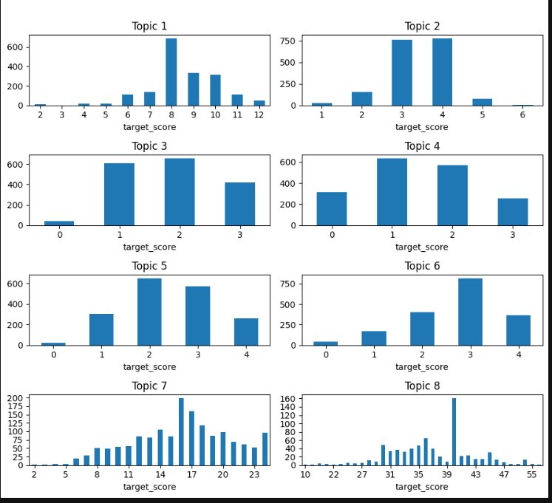
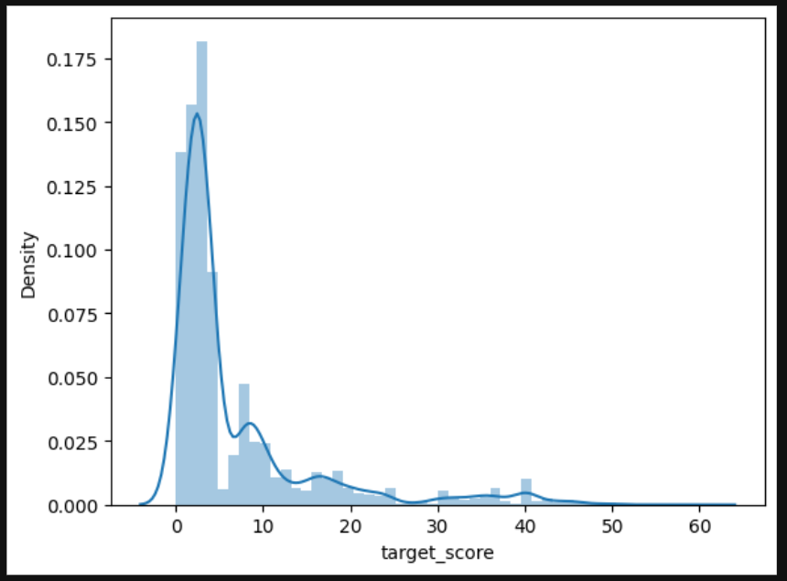
Company Name
CSCE 5300
Design of Features/labels with diagram
By comparing the features and concluded useful features from the dataset,categorized the features: essay_id,topic,essay,target_score of the data set ,and plotted the 8 essay topics by target score.
Analyzed the score of the total essays, plot the graph.

Slide 7

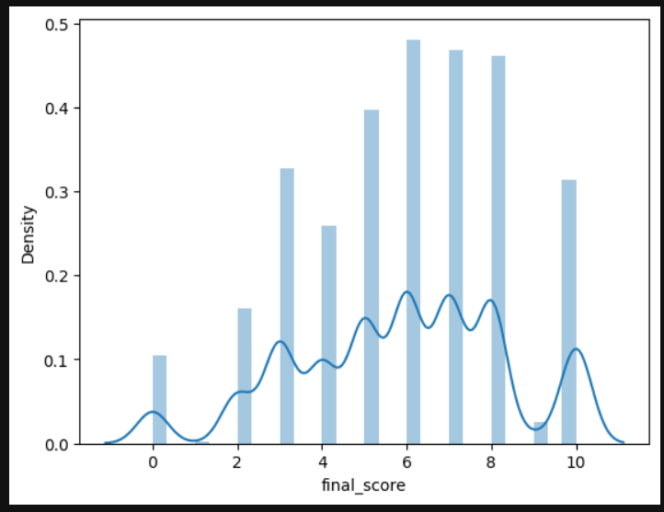
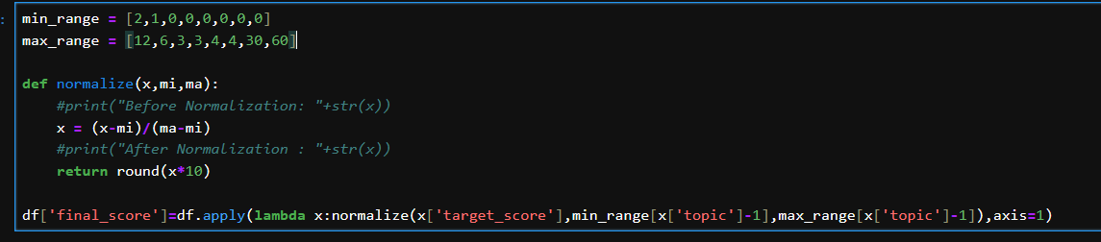
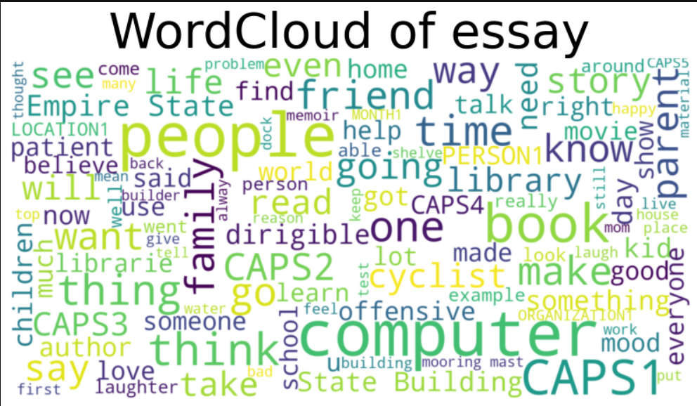
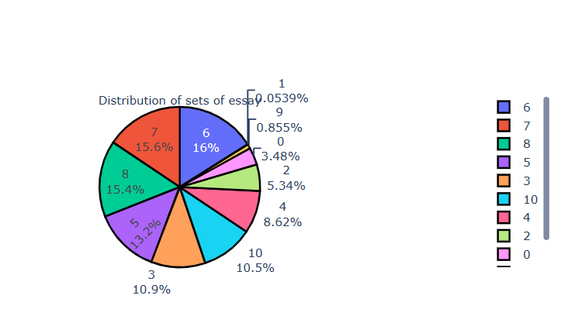
Data Visualization and data preprocessing
Data preprocessing: as the target score is high in some columns and low in some columns, we normalized the and stored in final_score.

Slide 8
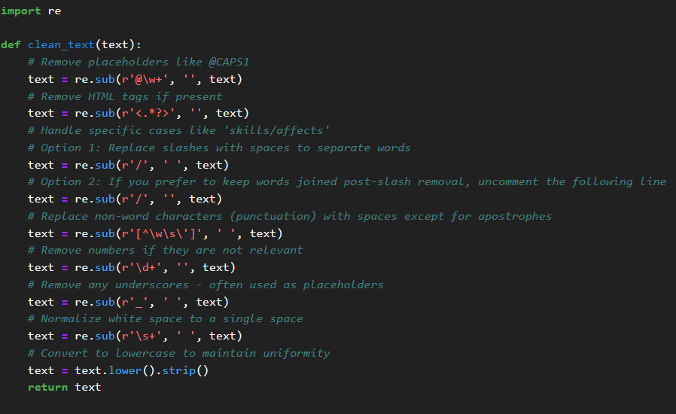
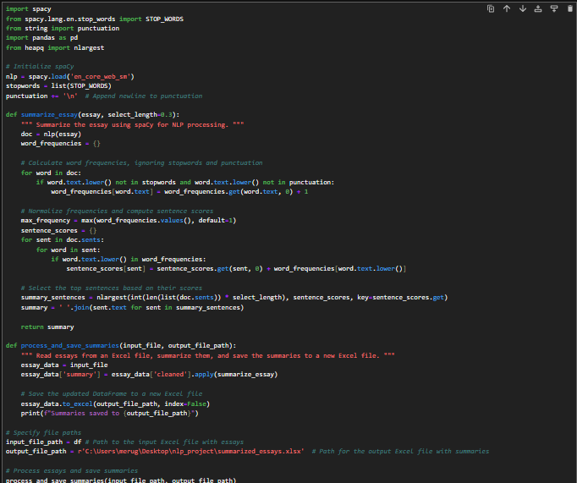
Data Visualization and data preprocessing
Data preprocessing: data cleaning for the given essay using regular expression clean html tags, special symbols, slashes, on word punctuation ,numbers, white spaces and convert them to lower case.
For the clean text in the essay ,we process the text summarization from the learning concept of the course using spacy library , using stop words and punctuation cleaned further text and stored in summary field and exported the excel file.

Slide 9
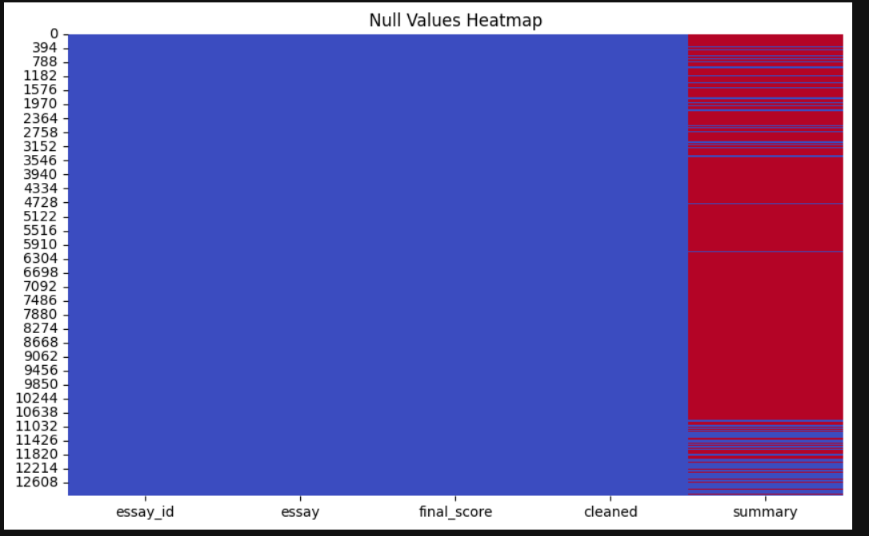
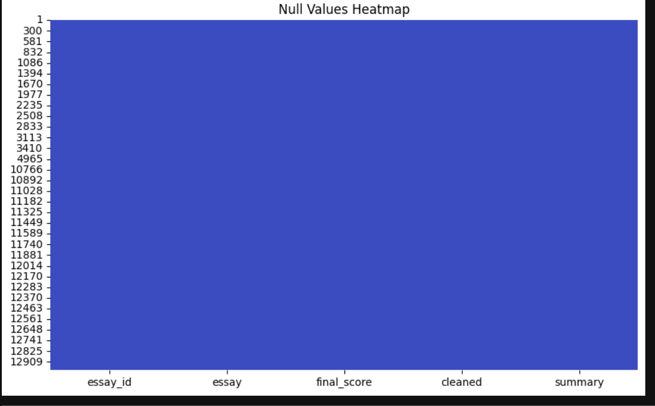
Data Visualization and data preprocessing
Data preprocessing: after summarizing the essay,before traing checking the null fields and cleaning it. Here are the heatmap representation of the analysis.

Slide 10

CSCE 5300
Implementation
NLP libraries
spaCy: It is anopen-source NLPlibrary designedfor performing complex NLP tasks with ease. spaCy is knowfor its speed and efficiencyand comes with pre-built statistical models and word vectors.
Regular Expression (re):Regular expressions are used forstring searching and manipulation, oftenfor complex patterns of text. For instance, you mightuse regular expressions tovalidate email addresses, removeunwanted characters, find all URLs in a text, orperformsubstitutionsin a string.
String:It's oftenused intext processing toremove punctuation from textbeforeprocessing or tokenizing because punctuationmarks caninterfere with how text is interpreted or analyzed.
Common Librarie
Numpy:It's heavilyused in numericalcomputations, data transformation, and is a key libraryin the ecosystem of scientific computing inPython.
Pandas: It providesdata structures likeDataFrames and Series, which are ideal for working withstructureddata. Pandas is widelyused for data processing, cleaning, andanalysis.
Seaborn: It offers a more powerful and simpler interfacefor creatingcomplex visualizations, including various plot types like scatter plots, barcharts, and violinplots, with sensibledefault designs.
matplotlib.pyplot: It's used for creating static, interactiveand animated visualizations in Python.

Slide 11

Model 2:Libraries ,algorithm and implementation
Logistic regression:
Logistic Regression is astatistical algorithm usedprimarily forbinary classification problems, whichis a type of predictiveanalysis. Regressionmodels the probabilities for classification probles with two possibleoutcomes. It’s an exension of the linearregression model for classification tasks.
Eg:"Spam" or "NotSpam" in email filteringsystems.
"Maligant" or "Benin" for a tumor diagnosis.
Weused this algorithm to analyzethe summarized essay for classification of scorebased on essay. And used metrics for testing modellearning:Accuracy, Precision ,Recall ,F1 Score,confusionmatrix

Slide 12
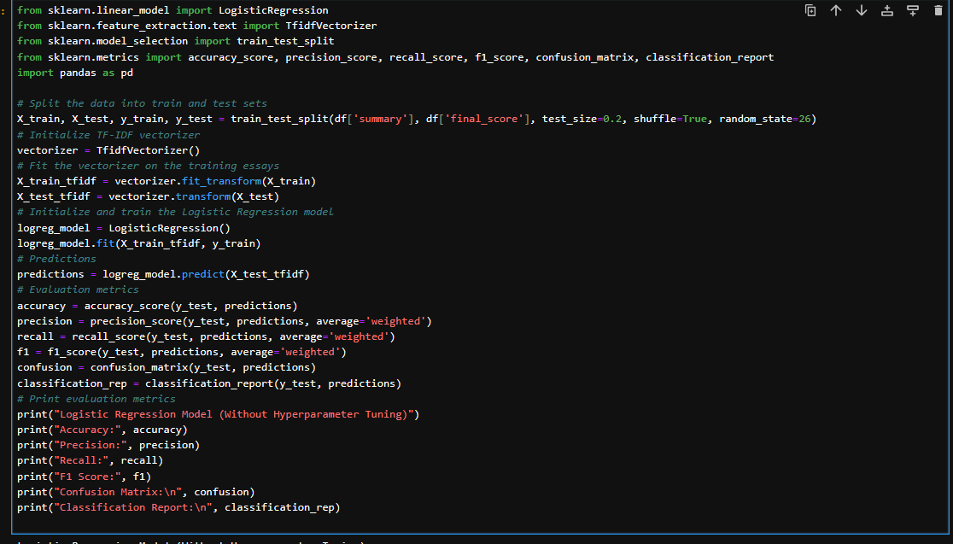
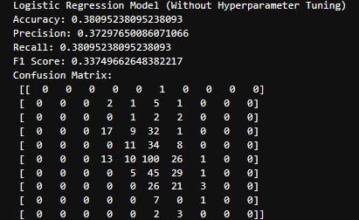
Model 2:Libraries ,algorithm and implementation
Logistic regression:

Slide 13
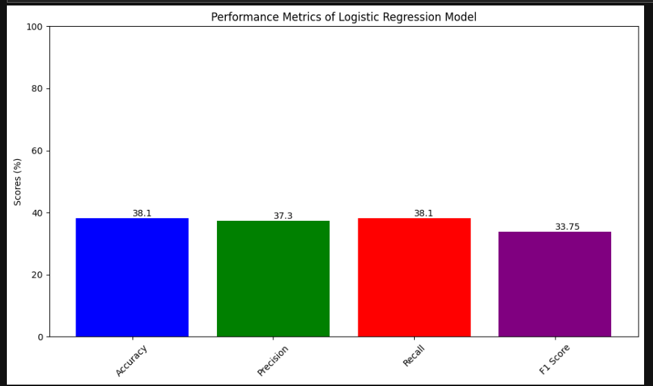
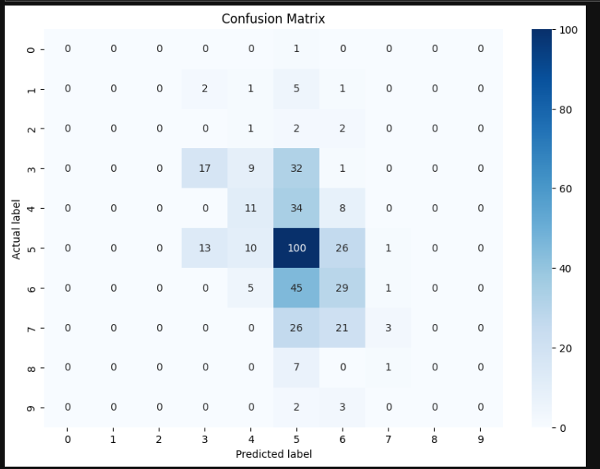
Model 2:Libraries ,algorithm and implementation
Logistic regression:

Slide 14
Model 2:Libraries ,algorithm and implementation
Logistic regression:we divided the dataset in 80 for training and testing.
fidfVectorizer from sklearn.feature_extraction.text is usedto convert thetext data into numericalfeatures suitable formodel training.
A LogisticRegression model is instantiatedand trained on the vectorized training data (X_train_tfidf).
the trained model is used to predict the scores of thevectorized test data (X_test_tfidf).
Accuracy: The proportion of total predictions that were correct.
Precision (Weighed): The ability ofthe classifier not to label anegative sample a positive, with consideraton for the imbalance in class distribution.
Recall (Weighed): Theability of the clasifier to find all the postive samples, again weighted for class imbalance.
F1 Score (Weighed): A weighted average of precisionand recall, which balances both metrics.
A confusion matrix isgenerated, showing true positives, falsepositives, truenegatives, and falsenegatives.

Slide 15

CSCE 5300
CSCE 5300
Decision tree
Decision Tree:
Decision Trees are a type of SupervisedMachine Learning algorithmthat is predominantly used forclassification problems, but can also be adapted for regression.
A Decision Tree algorithmsegments the dataset into branches toform a treestructure. Each internalnode of the treerepresents a test on anattribute (e.g., whether a coinflip comes up heads or tails), each branch represents the outcome of the test, and each leafnode represents a classlabel (decision taken aftercomputing all attributes)
We used this algorithm to analyze thesummarized essay for classification of scorebased on essay. And usedmetrics for testing model learning:Accuracy, Precision ,Recall ,F1 Score,confusion matrix

Slide 16
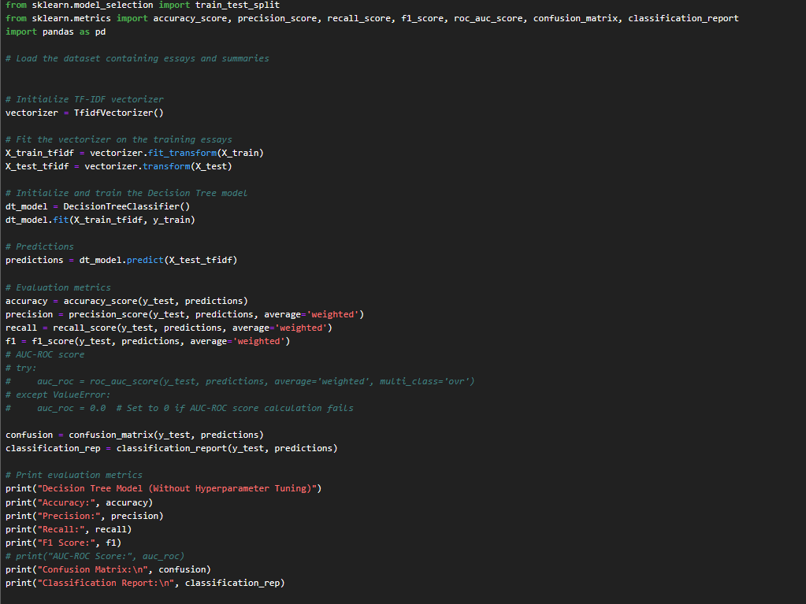
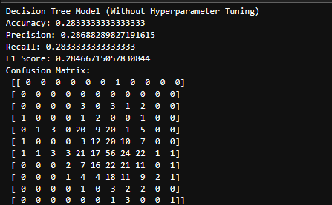
CSCE 5300
CSCE 5300
Decision tree
Decision Tree:

Slide 17
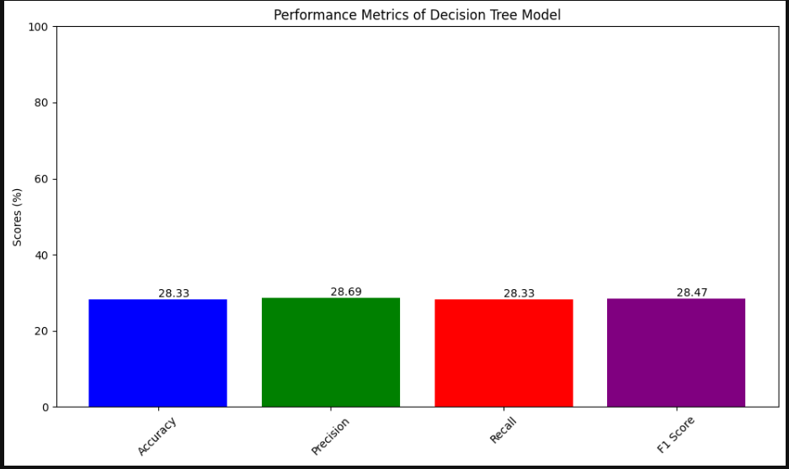
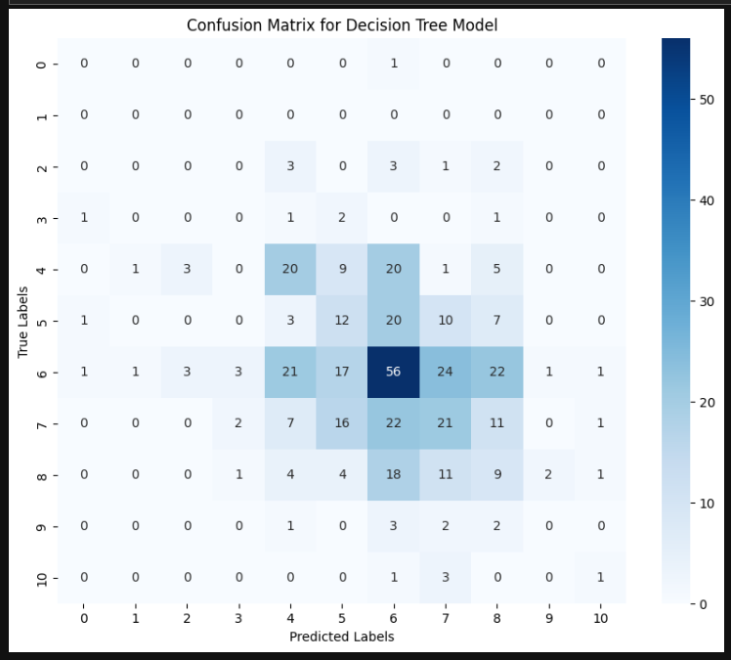
CSCE 5300
CSCE 5300
Decision tree
Decision Tree:

Slide 18
CSCE 5300
CSCE 5300
Decision tree
Decision Tree:
we divided the dataset in 80 for training and testing.
fidfVectorizer from sklearn.feature_extraction.text is used toconvert the textdata into numericalfeatures suitable for modeltraining.
A DecisionTree model is instantiated and trained on the vectorizedtraining data (X_train_tfidf).
the trainedmodel is used to predict the scores of the vectorizedtestdata (X_test_tfidf).
Accuracy: The proportion of totalpredictions that were correct.
Precision (Weighed): The ability of the classifiernot to label a negativesample as positive, with consideration for theimbalance in classdistribution.
Recall (Weighed): The ability of the classifier to find all the positivesamples, again weighed for class imbalance.
F1 Score (Weighed): A weighed average of precision andrecall, which balance both metrics.
A confusion matrix is generated, showingtrue positives, falsepositives, truenegatives, and falsenegatives.

Slide 19

Neural Network
A neuralnetwokmodel is a comptationalframework inspired by the biologicalneralnetworks that constitute anmalbrains. It is capable of learning from obervationaldata and has become a cornerstone for manyapplications in artificialintelligence, including image andspeech recognition, naturllanguageprocessing, and roboticcontrol.
Basic Struture:
Neurons: The fundamental units of a neuralnetwork are artificianeurons or nodes. Each neuron receivs input, procsses it, and generates an output.
Layers: Neurons are rgnizedlayers. There are theetypes of layers in a typicalneuralnetwork:
Input Layer: Receives the initialdata.
Hidden Layers: Intermediate lyers that process inputsreceived from previouslayers using weights, biases, and activatiofunctions.
Output Layer: Produces the finalotput ofthe moel.

Slide 20
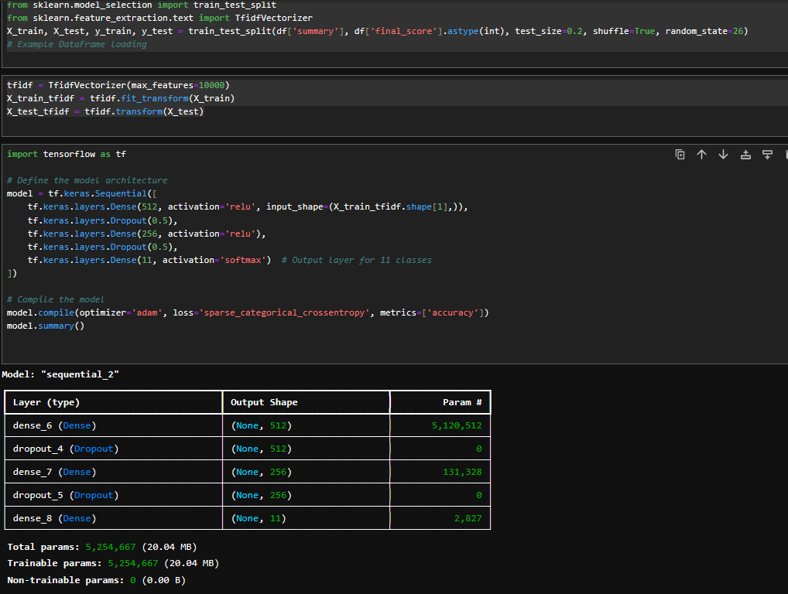
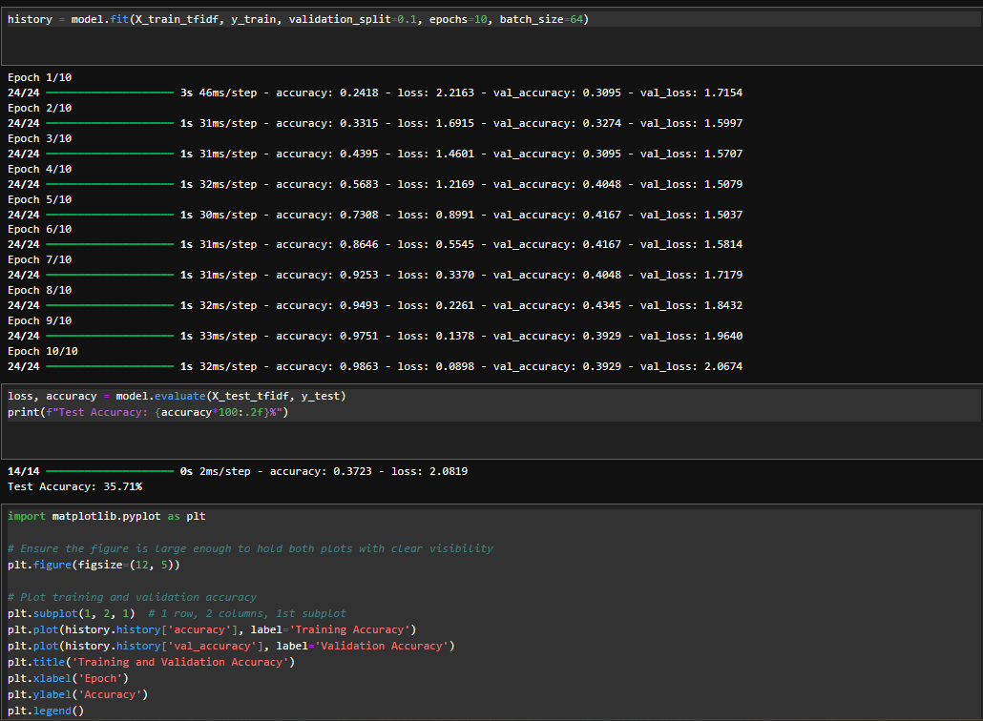
Neural Network

Slide 21
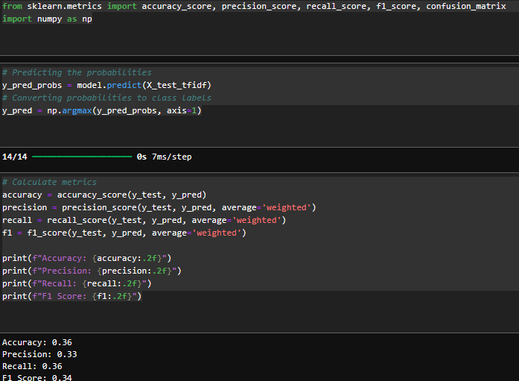
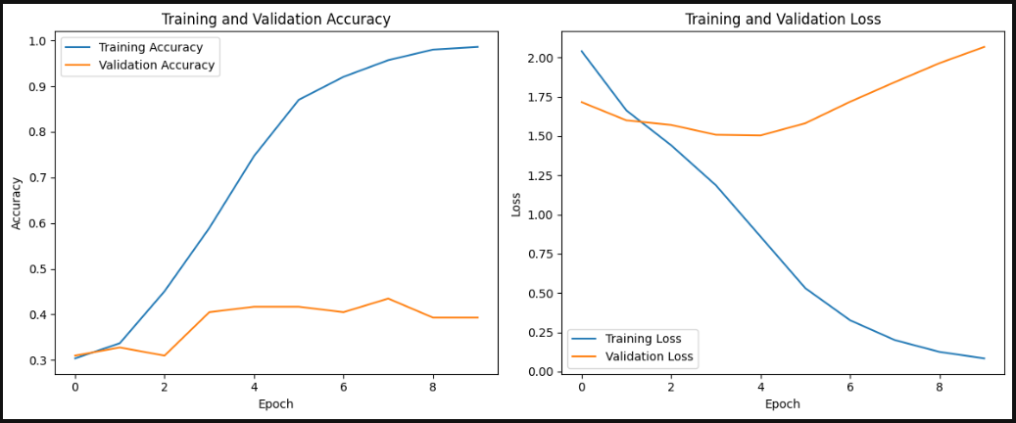
Neural Network

Slide 22
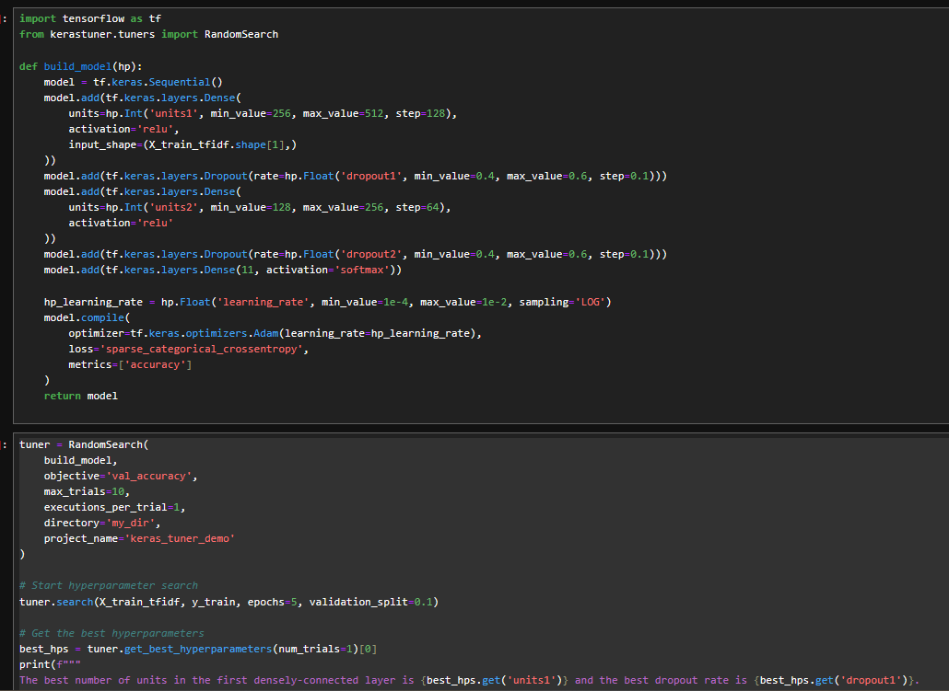
After hyperparameter tuning: neural network

Slide 23
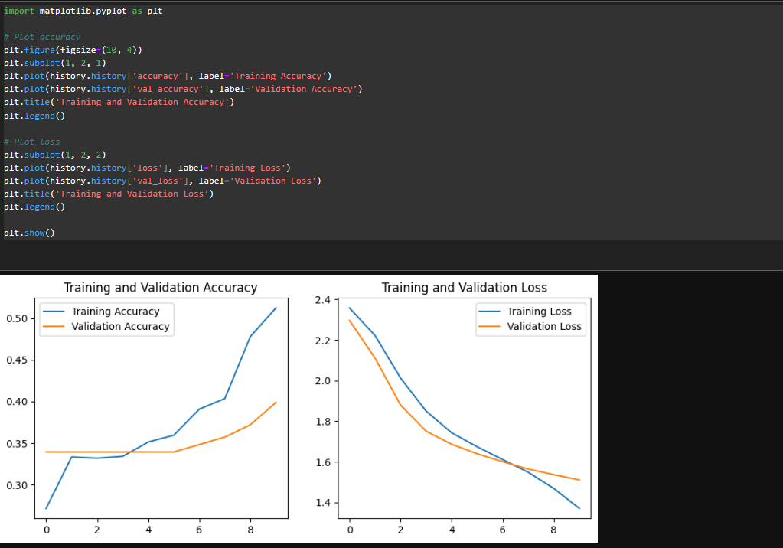
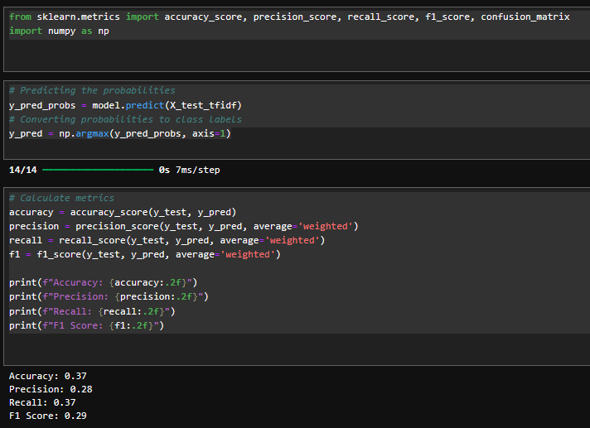
After hyperparameter tuning: neural network

Slide 24
After hyperparameter tuning: neural network
Dense Layers: Fully connectedlayers with a variablenumber of units (units1 and units2), both using ReLU activationfunctions. The number of units for theselayers is chosenbased on the hyperparameter search spacedefined for units1and units2.
Dropout Layers: Used to prevent overfittingby randomlysetting a fractionof input units to 0 duringtraining. Dropout rates (dropout1 and dropout2) are alsovariable.
Output Layer: A softmaxlayer suitable for multi-classclassification with 11 outputclasses.
Optimization and Compilation:
The learningrate for the Adamoptimizer is varied within a specified range using a logarithmic scale (sampling='LOG'), which is effective forexploring orders ofmagnitude.
The model uses sparse_categorical_crossentropy as the lossfunction, which is typical for multi-class classificationtasks where labels areprovided as integers.
Kera's Tuner Configuration:
Random Search: A tunerthat performs a randomsearch on hyperparameters, optimizingfor val_accuracy.
The search evaluates 10 differentconfigurations (max_trials=10) with each configuration run once (executions_per_trial=1).
The directory and projectname specifywhere trial data isstored

Slide 25
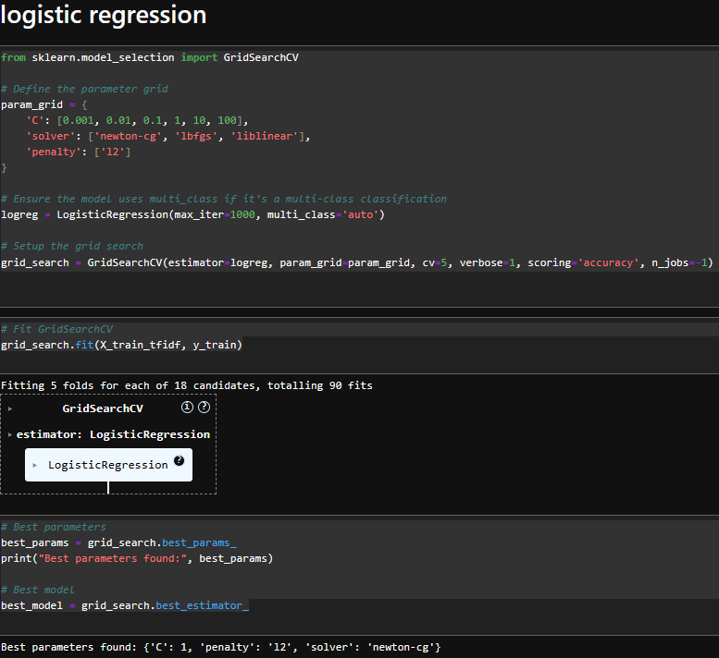
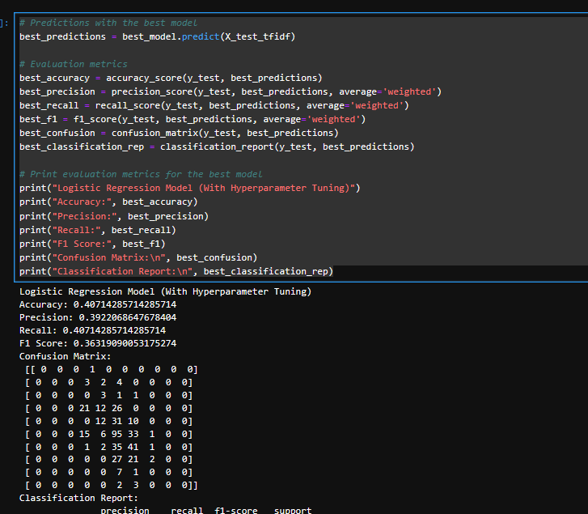
CSCE 5300
After hyperparameter tuning: Logistic Regression

Slide 26
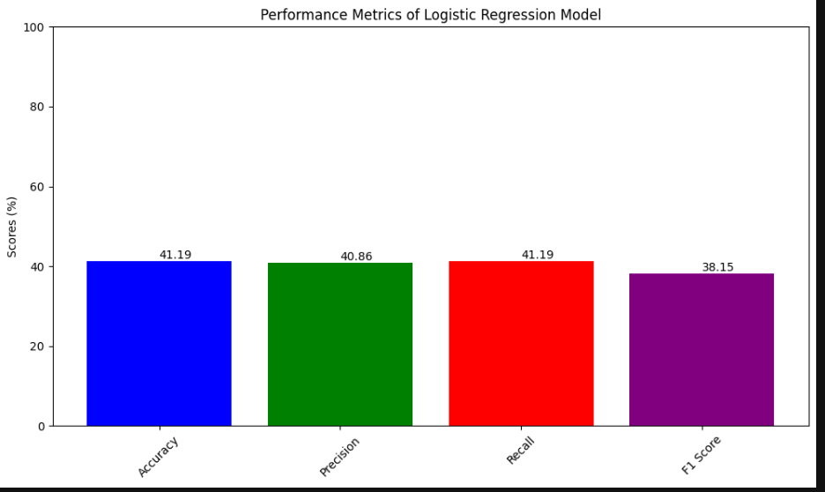
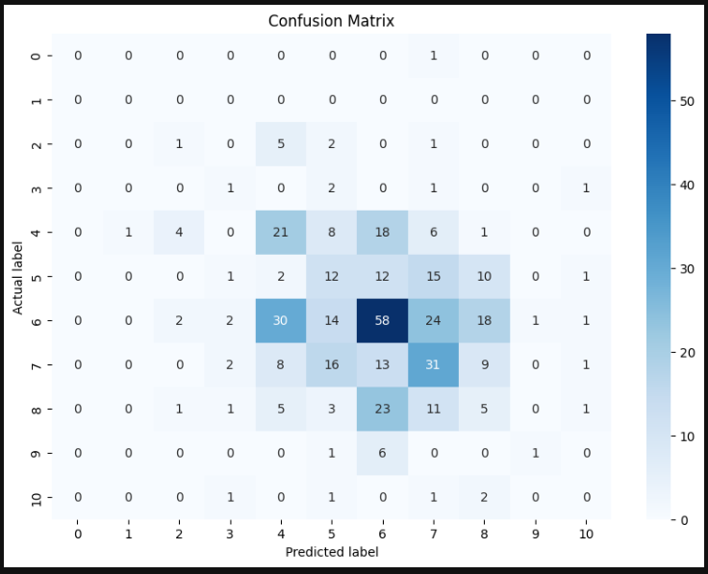
CSCE 5300
After hyperparameter tuning: Logistic Regression

Slide 27
CSCE 5300
After hyperparameter tuning: Logistic Regression
Setting up Gridsearch CV:
ParameterGrid: A dictionary (param_grid) definesthe space over which parametersshould be searched. This includes:
C: Regularization strength, which inverselyscales with overfiting. Several values are tested from very weak tovery strong regularization.
Solver: Different algorithms forsolving the optimization problem (newton-cg, lbfgs, liblinear). Each solver worksdifferently under various conditions and is suitable for different types of data.
Penalty: The type of regularization applied (l2 indicates L2 regularization).
Logistic Regression Configuration: The base model is configured with a high max_iter to ensure convergenceand set to handle multi-class classification automatically (multi_class='auto’).
Grid Search Configuration: GridSearchCV is nitialized with the Logisic Regressionestimator, the parameter grid, and the strategy for cross-validation (cv=5 indicates 5-fold cross-validation). It aims to maximize accuracy (scoring='accuracy'), and it is settoperform computations in paralel (n_jobs=-1 uses all available CPU cores).

Slide 28
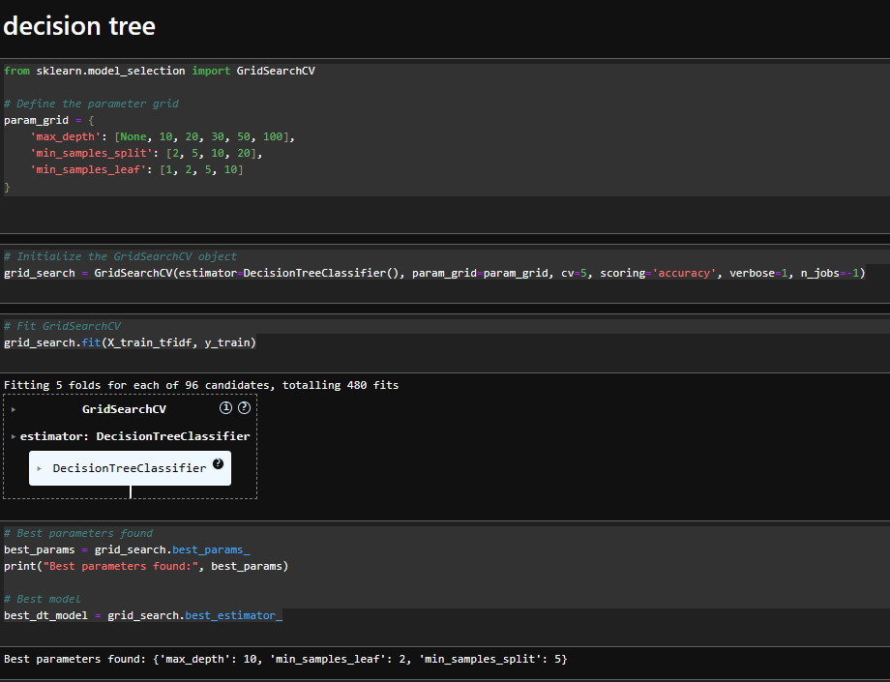
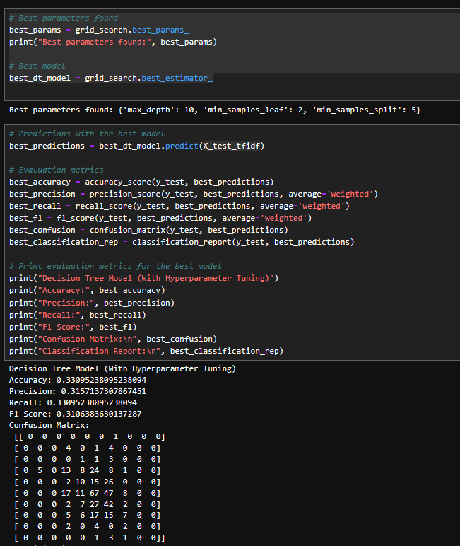
CSCE 5300
After hyperparameter tuning: Decision Tree

Slide 29
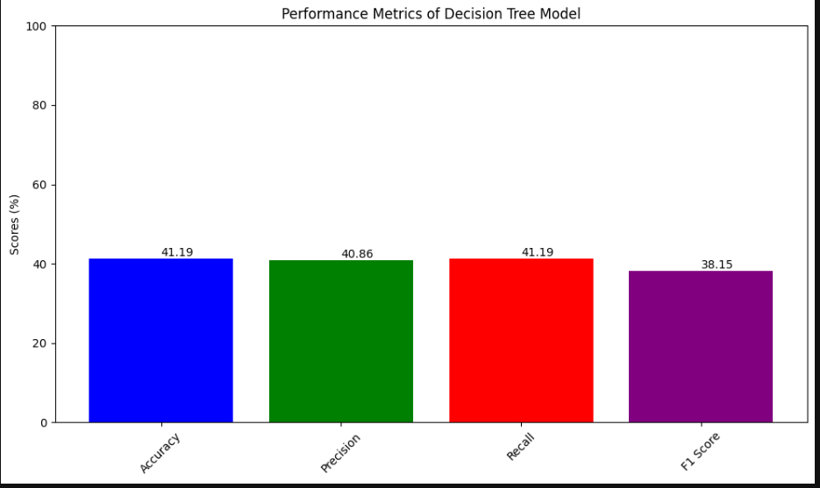
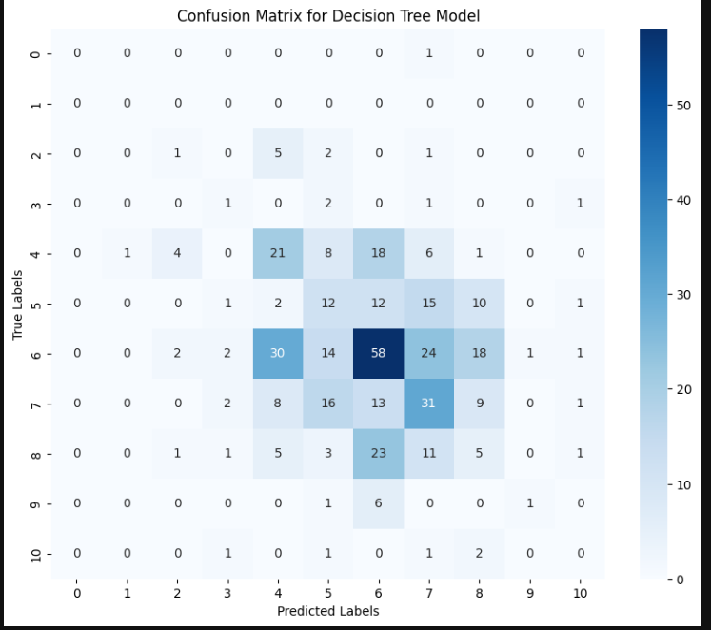
CSCE 5300
After hyperparameter tuning: Decision Tree

Slide 30
CSCE 5300
After hyperparameter tuning: Decision Tree
Setting up Gridsearch CV:
Paraeter Grid Definition: A dictionary (param_gid) is crated tspecify the rangeof values for varius hyperparameters of the DecisionTreeClassifier:
max_depth: Contols the maxium deth (or levels) of the tree. Deepertrees can modl more comlex pattrns but are prone to overfitting.
min_samples_split: The minimumnumber of saples required tosplit a internal node. Higher values prevet the modelrom learning overly specificpatterns, thus lowering the riskofoverfittng.
min_samples_leaf: Theminimum number of samples a leaf node must have. This paameter further helps in controllingoverfitting.
GridSearchCV Configuration: An instance of GridSearhCV is initializd with the Decison Tree Classifier as theetimator. It uses the definedpaameter grid to exploredifferent configrations. The seach straegy inclues:
cv=5: 5-fold cross-validationto ensure the model's prformance is robstacross differen subsets of thedataset.
scoring='accuracy': Optimization citerion is the accuracy of the predictions.
vebose=1: Outputs detiled logging information during the training process.
n_jobs=-1: Utilizes all available CPU core to parallelize the training.

Slide 31

CSCE 5300
CSCE 5300
Project Management

Slide 32

Person | Task | Description | Contribution | Issues faced
Sai Gottumukkala | Visualize and Pre-process the dataset | To clean the essay dataset using special symbols, slashes etc. | 100% | Data available was less, further after cleaning and summarization, more data was lost resulting in degradation of ML models from the summary.
Sai Charan Merugu | Model analysis using Neural Network | To design a neural network model that can classify the grade | 100% | Data available was less, further after cleaning and summarization, more data was lost resulting in degradation of ML models from the summary.
Company Name
CSCE 5300
CSCE 5300

Slide 33
Person | Task | Description | Contribution | Issues faced
Swetha Guntupalli | Model analysis using Logistic Regression | To design a model that can grade the input summarized essay text. | 100% | Data available was less, further after cleaning and summarization, more data was lost resulting in degradation of ML models from the summary.
Karishma Bollineni | Model analysis using decision tree | To train and implement decision tree, neural network and measure the metrics. | 100% | Data available was less, further after cleaning and summarization, more data was lost resulting in degradation of ML models from the summary.
Company Name
CSCE 5300
CSCE 5300

Slide 34

References
The Hewlett Foundation: Automated Essay Scoring “https://www.kaggle.com/c/asap-aes/data”
Text Summarization
“https://cs.nyu.edu/~kcho/DMQA/”
Keras
“https://keras.io/keras_tuner/”

Slide 35

Thank you

